Slide 1
IOS FRAMEWORK
ARKIT
USER NOTIFICATION
CORE LOCATION

Slide 2
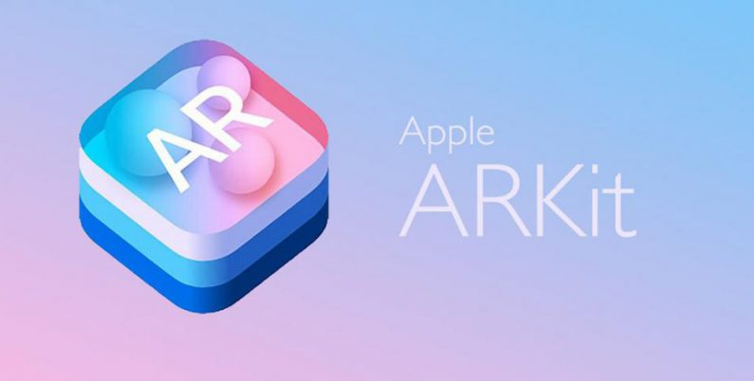
ARKIT
Integrate device camera & motion features to provide augmented reality experiences in your app or game.

Slide 3
WHY ARKIT
The augmented reality industry is one of the fastest growing and is projected to exceed $117 billion by 2022.(source: https://www.marketwatch.com/press-release/virtual-and-augmented-reality-market-is-expected-to-exceed-us-117-billion-by-2022-2018-07-26)

Slide 4
ABOUT ARKIT
Augmented reality describes user experiences in where 2d or 3d virtual elements are added to the live view of a devices camera. This is done in a way that makes those elements appear to inhabit the real world.

Slide 5
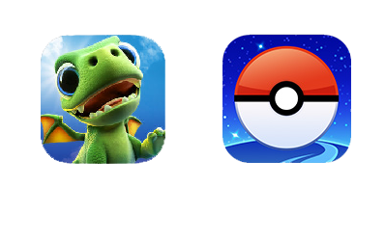
Apps using ARkit
AR Dragon
Pokemon Go

Slide 6
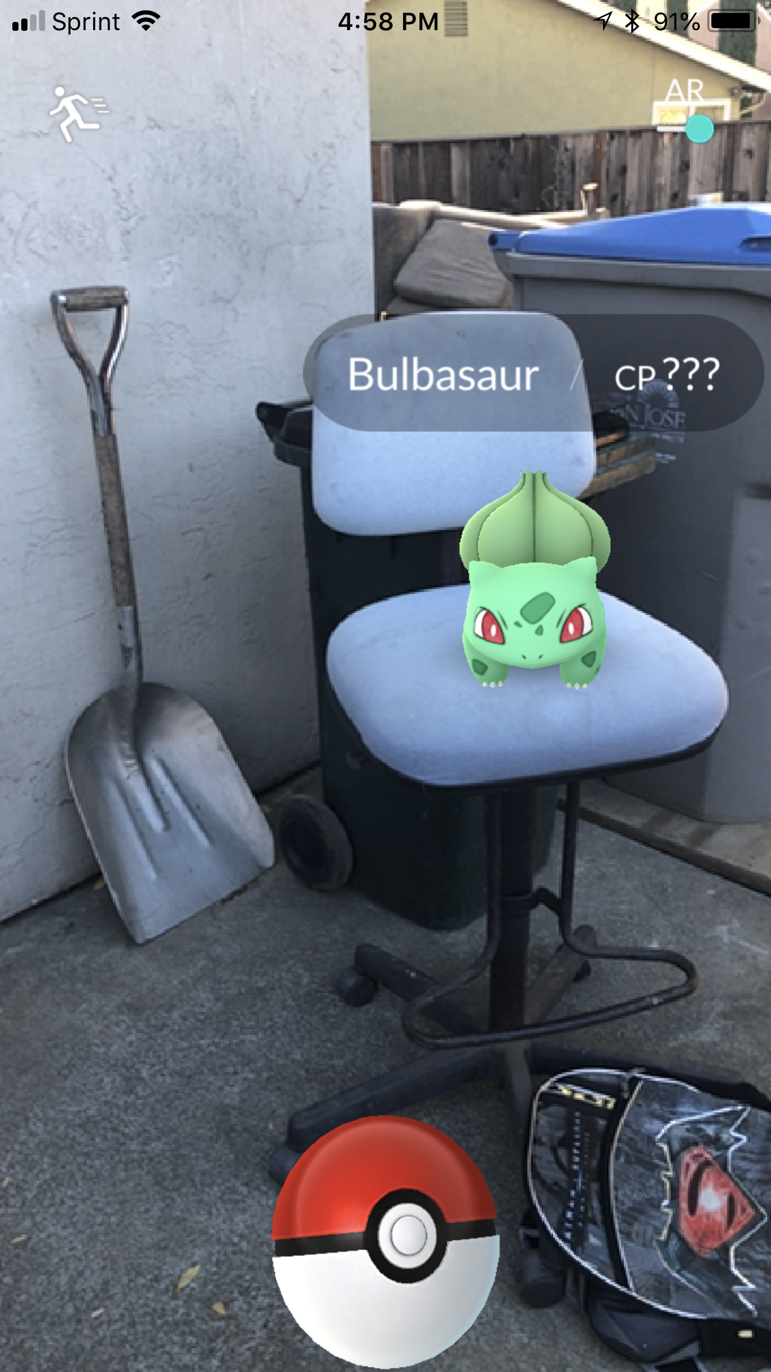
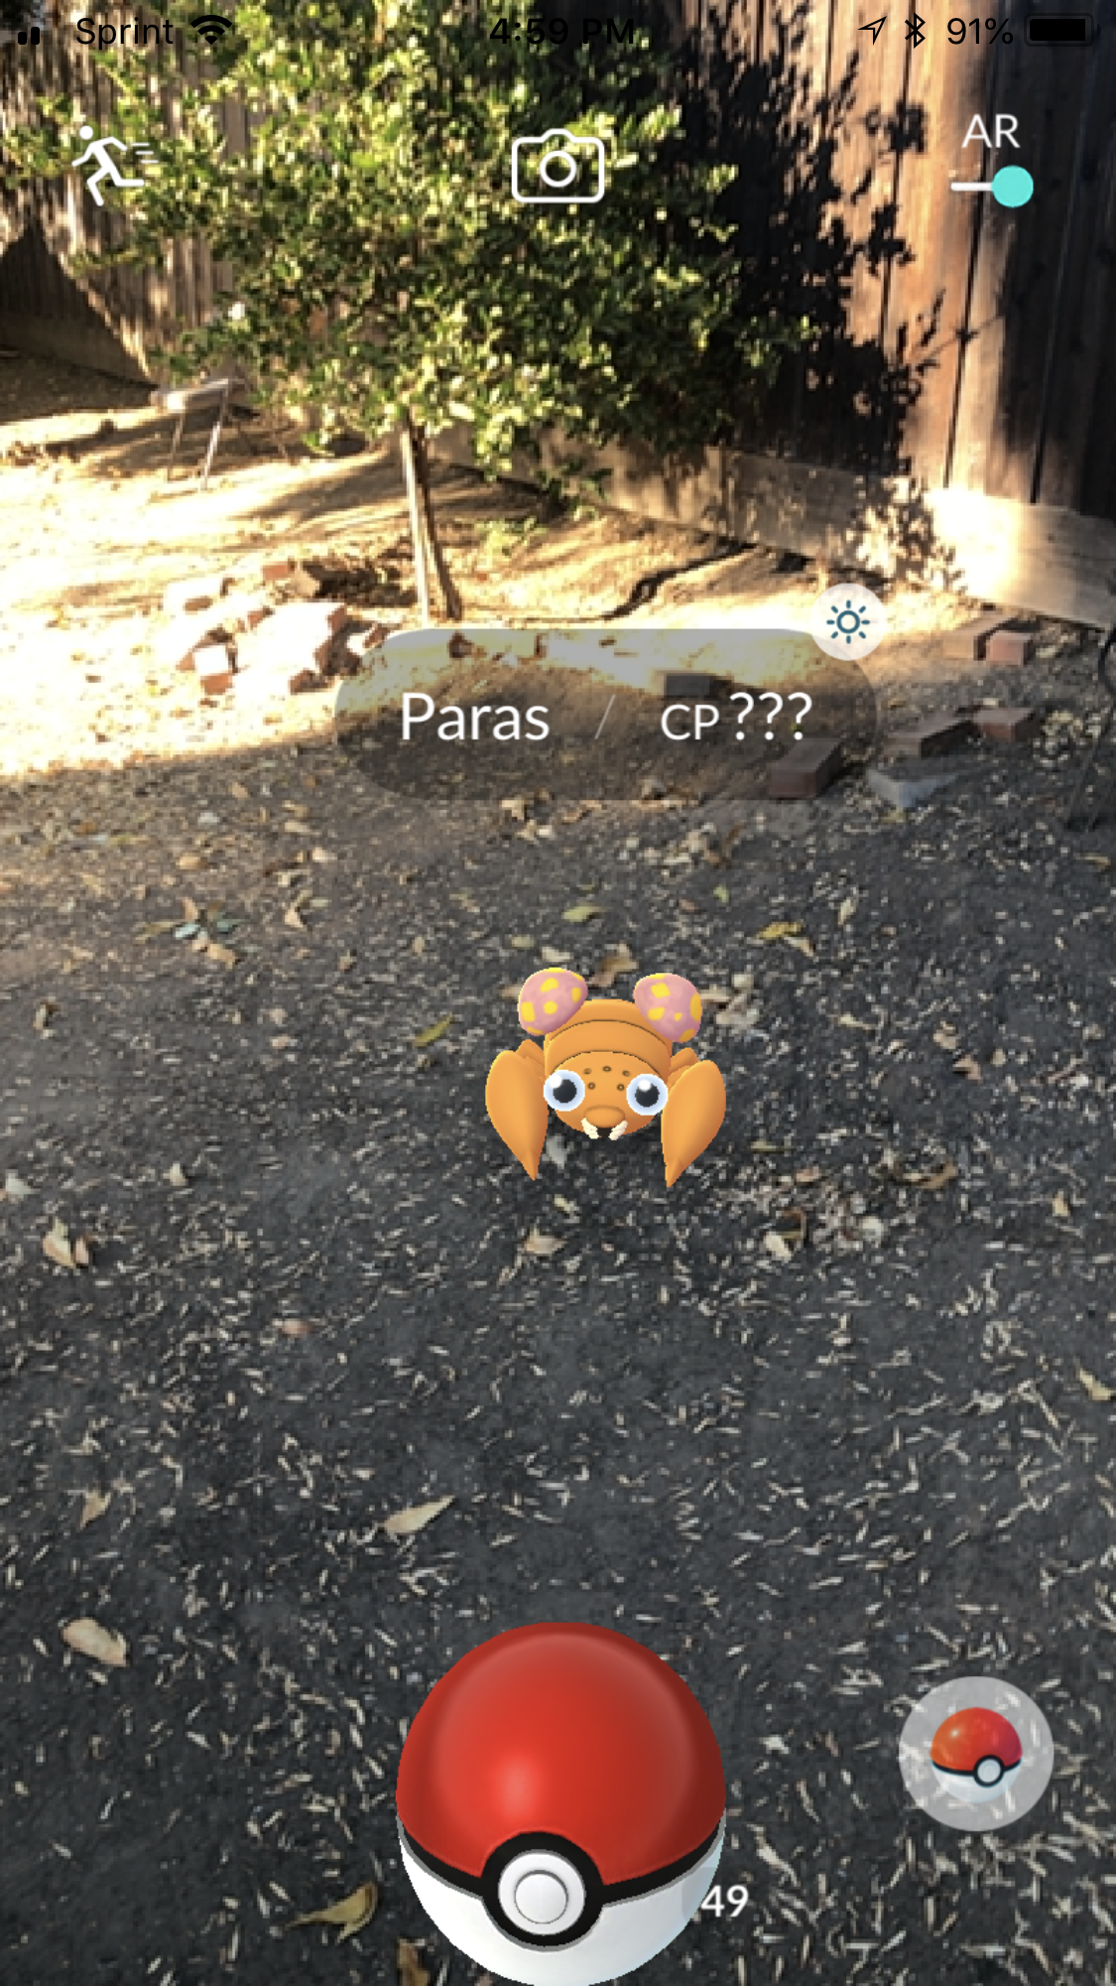
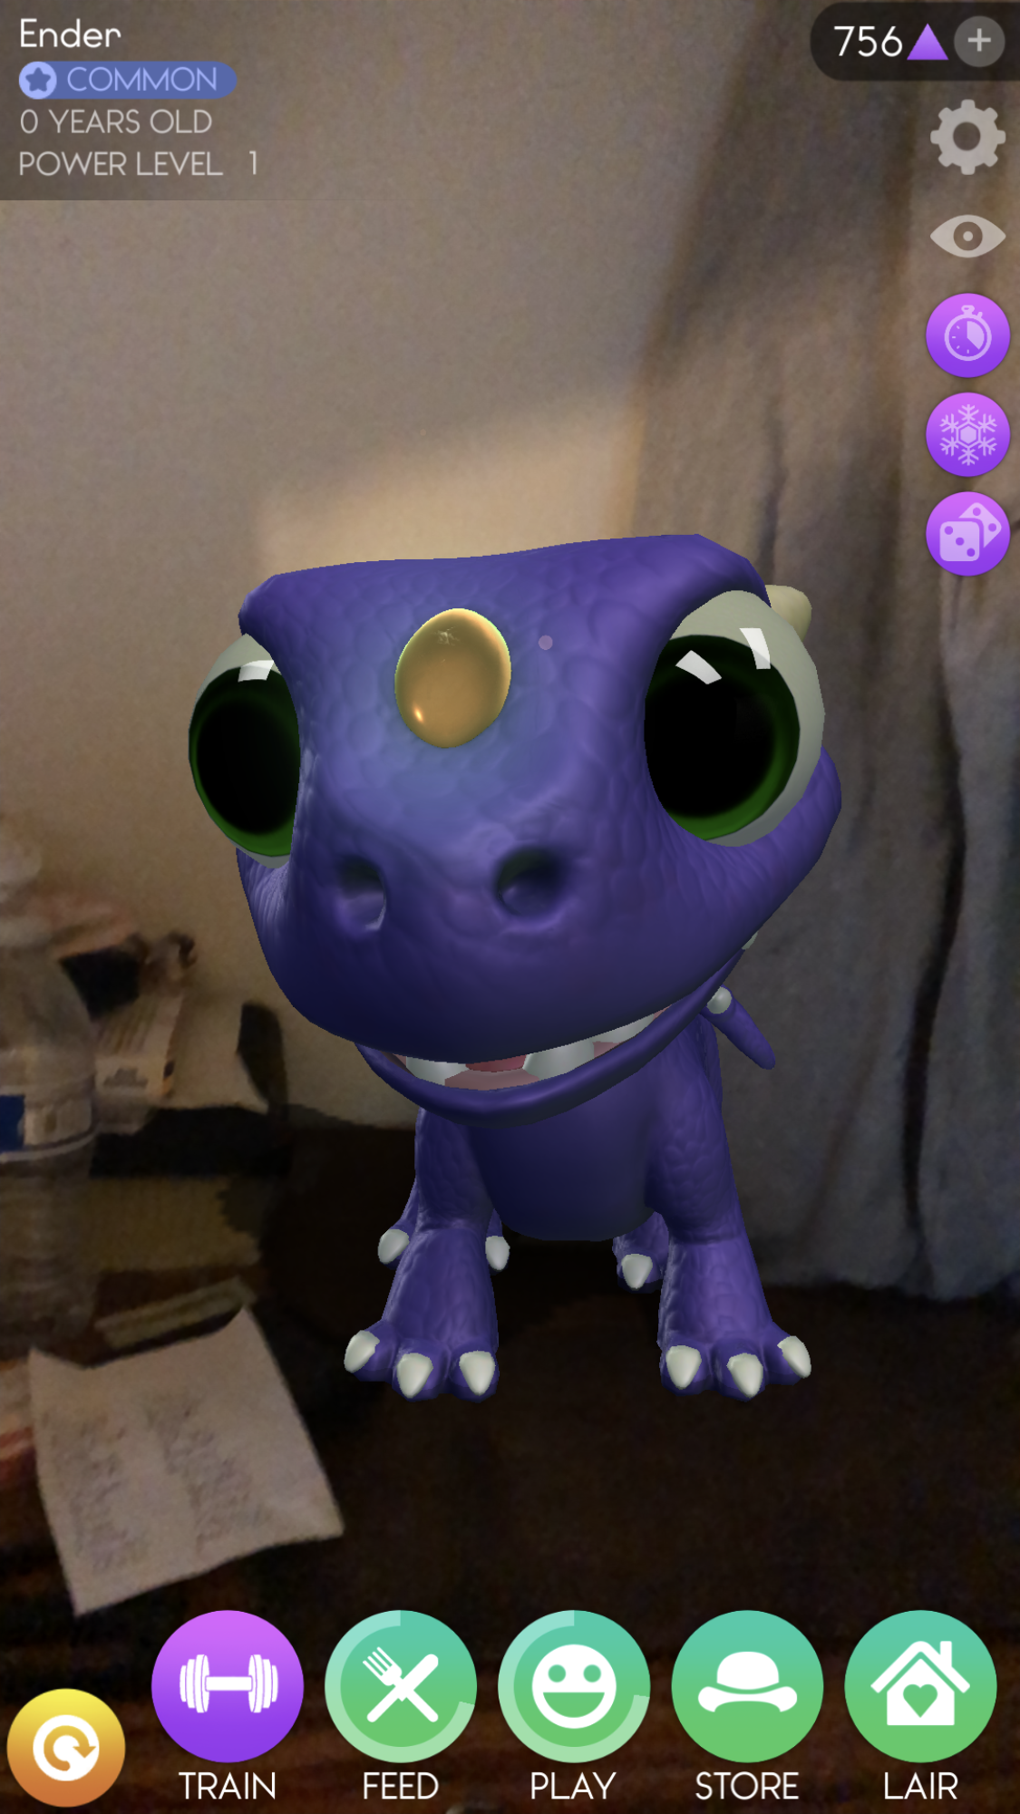
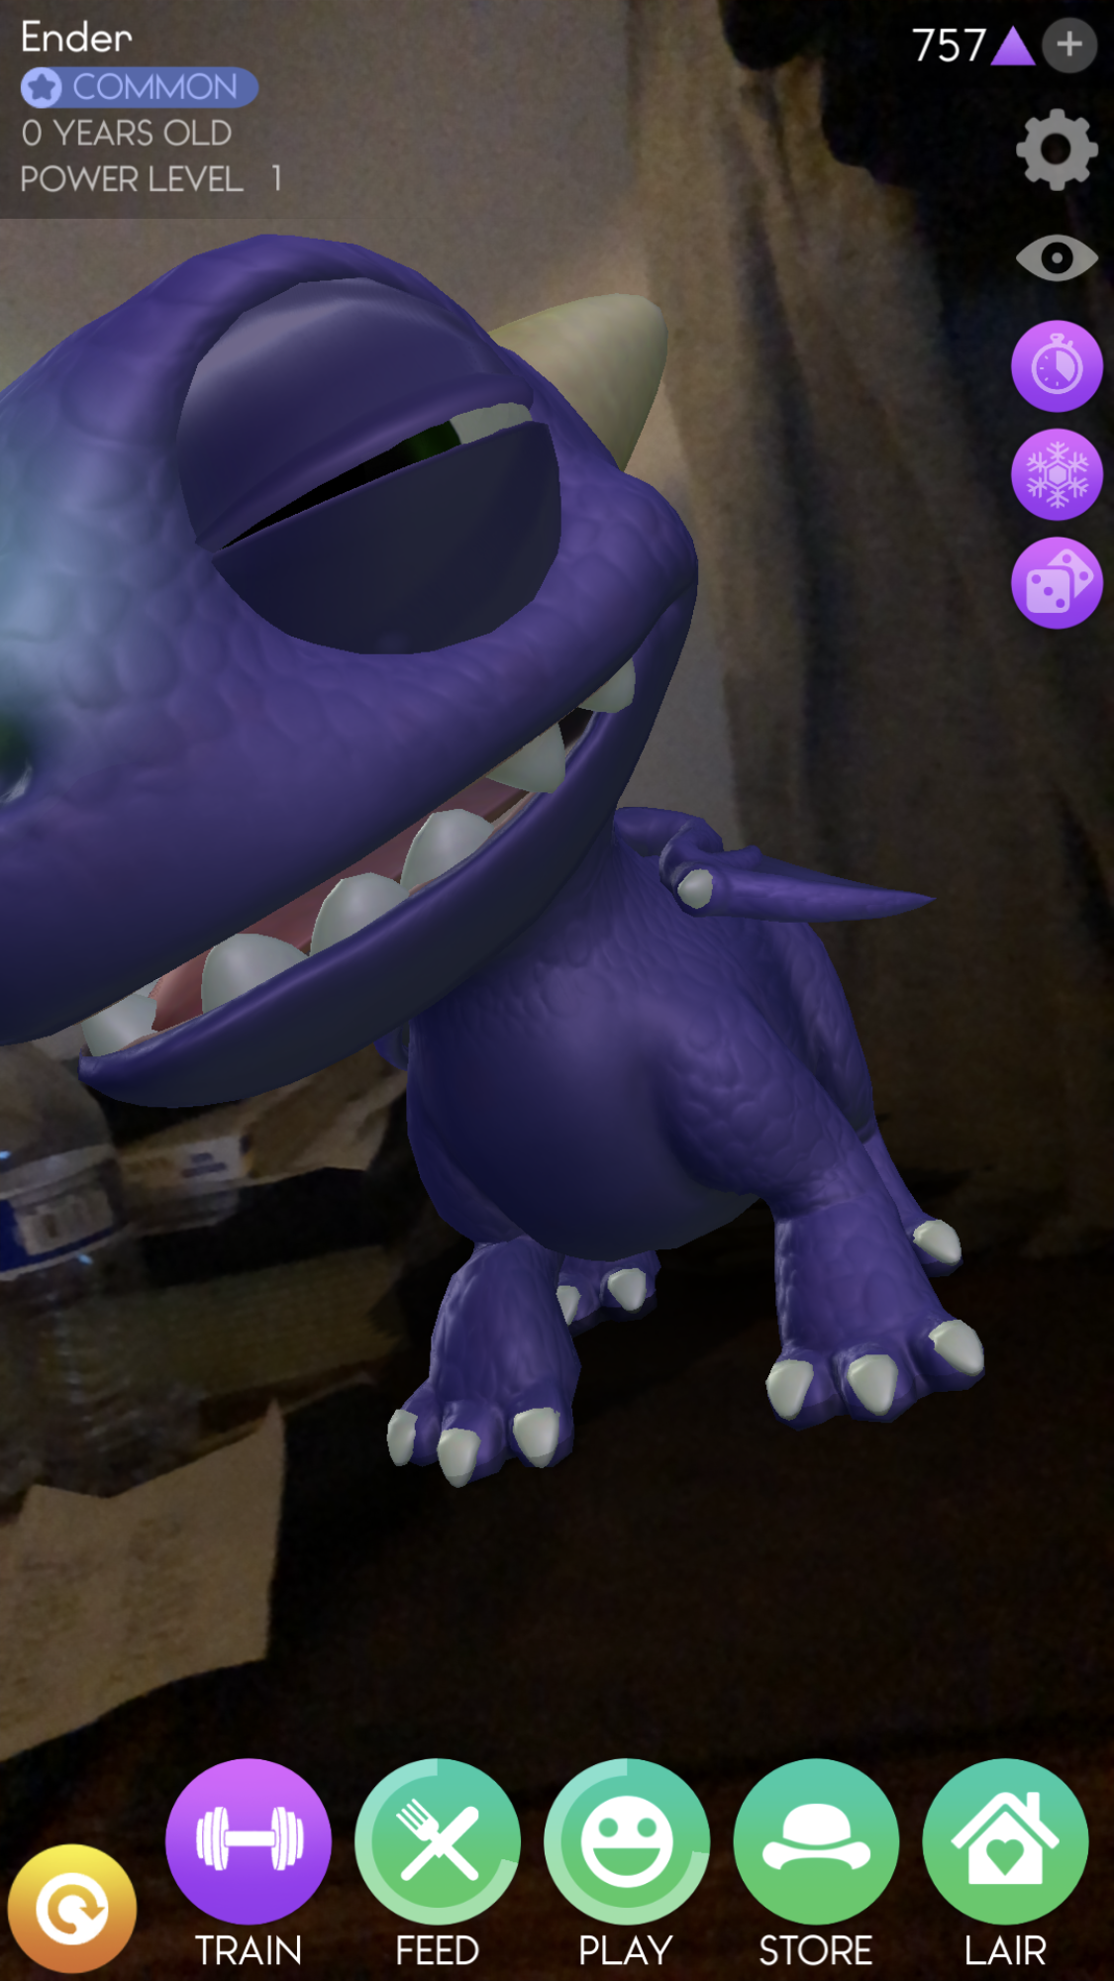
Both of these apps have ARkit dependant features that enable you to:
Capture creatures visible through the cameras view.(pic1,pic2)
Raise virtual pets.(pic3,pic4)

Slide 7
USERNOTIFICATIONS
Push user-facing notifications to the user's device from a server, or generate them locally from your app
Communicate important information to users of your app, regardless of whether your app is running on the user's device
Can also tell your app to download information and update its interface
Can display an alert, play a sound, or badge the app's icon
Local notification - the app creates the notification content and specifies a condition, like a time or location, that triggers the delivery of the notification
Remote notification - also known as push notifications, you use one of your company's servers to generate notifications, and Apple Push Notification service (APNs) handles the delivery of those notifications to the user's devices

Slide 8
USERNOTIFICATIONS CONTINUED…
class UNUserNotificationCenter - The central object for managing notification-related activities for your app or app extension.
protocol UNUserNotificationCenterDelegate - interface for handling incoming notifications and notification-related actions.
class UNNotificationSettings - The object for managing notification-related settings and the authorization status of your app.
class UNNotificationRequest - A request to schedule a local notification, which includes the content of the notification and the trigger conditions for delivery.
class UNNotification - The data for a local or remote notification that was delivered to your app.

Slide 9
USERNOTIFICATIONS CONTINUED…
class UNMutableNotificationContent | class UNNotificationContent | class UNNotificationAttachment
class UNNotificationSound | struct UNNotificationSoundName | class UNNotificationCategory
class UNTextInputNotificationAction | class UNNotificationAction | class UNNotificationResponse
class UNNotificationServiceExtension | class UNTextInputNotificationResponse | class UNNotificationTrigger

Slide 10
Apps using UserNotifications
Facebook
Whatsapp
Youtube
Fitbit
Amazon

Slide 11
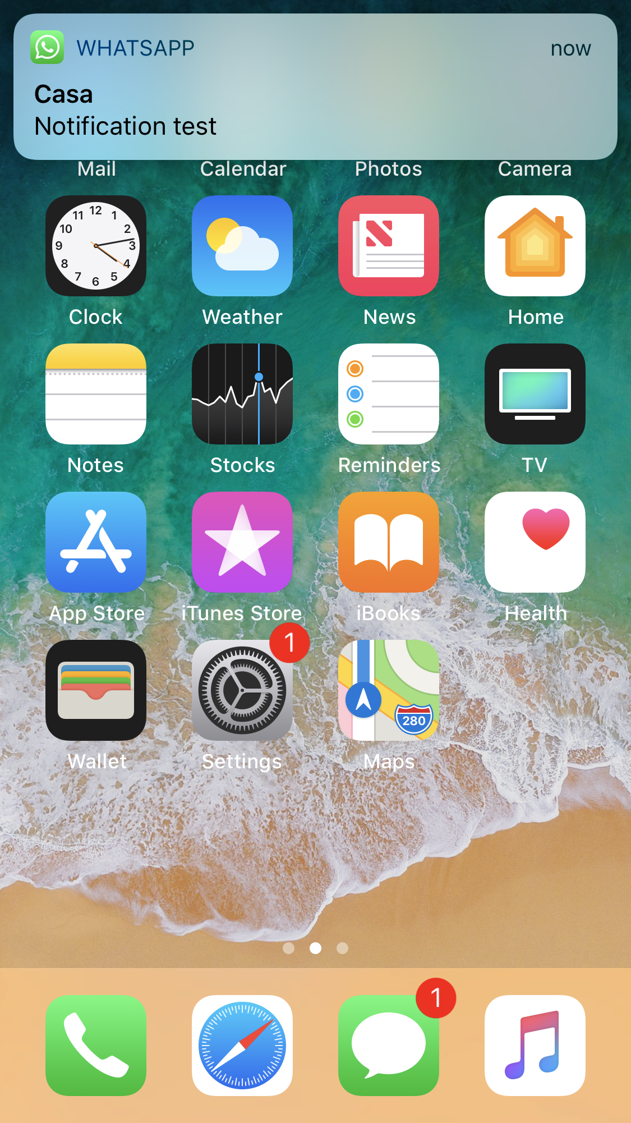
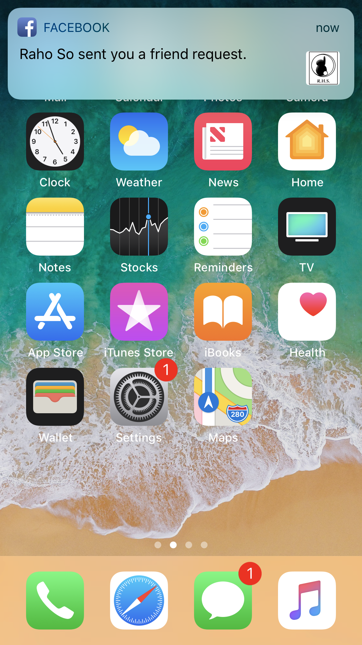

These apps utilize UserNotifications to notify users of things like:
New messages (Whatsapp-pic1)
New friend request (Facebook-pic2)
New comment (Youtube-pic3)

Slide 12
CORE LOCATION
services for determining a device’s geographic location, altitude, orientation, or position relative to a nearby iBeacon.
The framework uses all available onboard hardware to gather data.
(including Wi-Fi, GPS, Bluetooth, magnetometer, barometer, and cellular hardware)
ask for permission to use location services and determine the availability of those services on the current device.
Authorization Level for Location Services (when-in-use / always)
Availability of Location Services
class CLLocationManager
this class is used to configure, start, and stop the Core Location services
protocol CLLocationManagerDelegate
calls the methods of this delegate to report location-related events to your app
implement this protocol in an app-specific object and use the methods to update your app

Slide 13
CORE LOCATION CONTINUED…
Location updates
Visits location service / Significant-change location service / Standard location service
class CLLocation / struct CLLocationCoordinate2D / class CLFloor / class CLVisit
Regeion monitoring
determine when the user enters or leaves a geographic region
class CLCircularRegion / class CLRegion
iBeacon
a device that emits a Bluetooth signal that can be detected by your devices
class CLBeacon / class CLBeaconRegion
Campass headings (commonly used in navigation apps)
current orientation relative to magnetic or true north
Geocoding
convert between geographic coordinates and the user-friendly description of location
class CLGeocoder / class CLPlacemark

Slide 14
Apps using Core Location
Uber
Maps
Pokemon Go

Slide 15
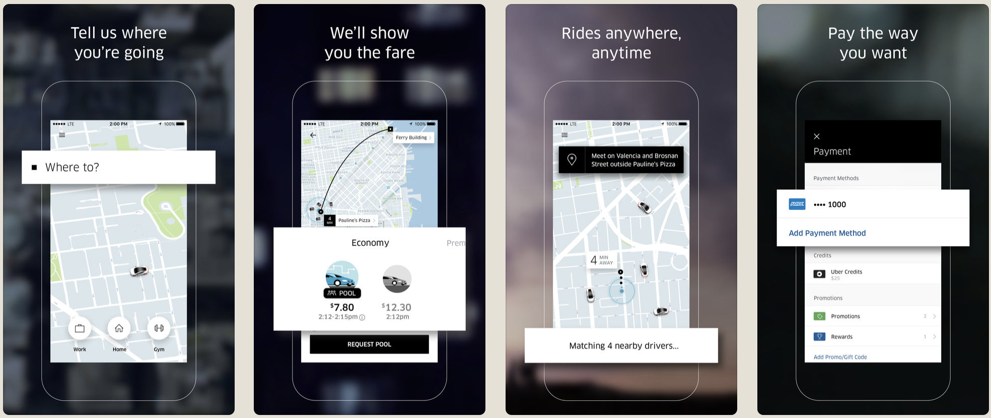
Core Location enabled these apps to have features like:
Navigation (Maps-pic1)
Geolocation (Pokemon Go-pic2)

Slide 16
AVFoundation
Work with audiovisual assets, control device cameras, process audio, and configure system audio interactions.
The AVFoundation framework combines four major technology areas that together encompass a wide range of tasks for capturing, processing, synthesizing, controlling, importing and exporting audiovisual media on Apple platforms.

Slide 17
Topics
Playback and Editing
Media Assets, Playback, and Editing Access and inspect media assets; queue media for playback and customize playback behavior; edit and combine assets; import and export raw media streams.
AirPlay 2 With AirPlay 2, you can wirelessly send your content from any Apple device to a device enabled with AirPlay.
Media Capture
Cameras and Media CaptureCapture photos and record video and audio; configure built-in cameras and microphones or external capture devices.
Audio
System Audio InteractionIntegrate system audio into your app.
Audio Track EngineeringPlay, record, mix, and process audio.
Speech
Speech SynthesisConvert text to spoken audio.
Structures
struct AVAudioSessionActivationOptions
struct AVMovieWritingOptions
Classes
class AVAssetResourceLoadingRequestorAn object that contains information about the originator of a loading request.
class AVRouteDetector
Reference
AVFoundation Enumerations
AVFoundation Constants
AVFoundation Data Types

Slide 18
